Slide 1



Digital Soil Mapping in R
Video 4 –Introduction to R
Essentials for Getting Started
Isabel Luotto

Slide 2
Table of contents:
What is and why R
Additional learning material for after you’re done with this course
RStudio orientation, how to take advantage of the GUI
Creating your first object and doing basic arithmetics
Functions - How to tweak them for what you need
Three common beginner’s mistakes in R and how to avoid them
What are indices
Types of objects in R with a focus on dataframes
Conditional selection, logic operators
Remove outliers and NAs
Basic graphs in R
Getting spatial

Slide 3
What is R?
R is a high level programming language and environment for statistical computing
It provides a wide variety of statistical (e.g. linear modeling, statistical tests, time-series, classification, clustering, etc.) and graphical methods, and is highly extensible
It’s Open Source, meaning that it’s not only free but also based on the contribution of Users → modular package structure
Add-ons (in R lingo “Packages”) extend the applicability of R to many fields, like in our case for geostatistics
e.g. install.packages('raster')

Slide 4
Why R?
Transparency and reproducibility everything you do in the analysis, from deleting outliers to interpreting results, is contained in your code
It is really hard to properly document the thought process behind a spreadsheet, and values (not calculations) can be changed with no record of their change
Powerful data manipulation capabilities. It can handle large datasets
State-of-the-art graphics
Click-oriented programs require more steps and can be very time consuming when trying to complete slightly demanding tasks

Slide 5
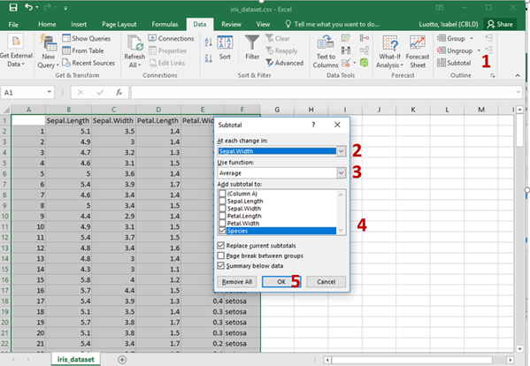
Why R? E.g.Taking the average of something per group
In excel it would take minimum 5 steps
While in R only one line of code is required
VS.
swm <- aggregate(Sepal.Width ~ Species, iris, mean)

Slide 6
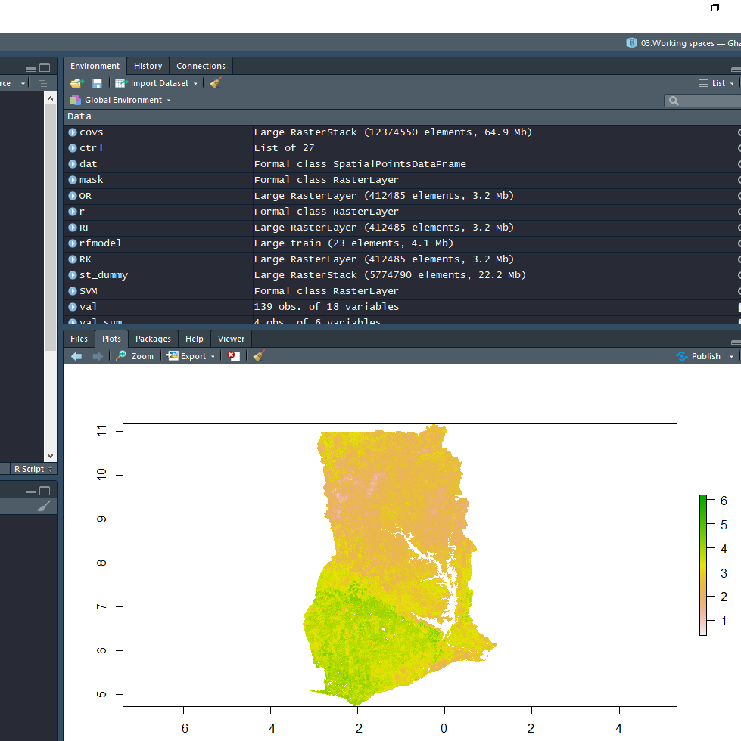
Why R?
Packages are basically a collection of functions for a given topic, which allow you to perform specific tasks
CRAN, the global repository of open-source packages that extend the capabilities of R have more than 10,000 R packages available for download
This has made R an essential tool for geostatistics and many other fields
Lot’s of free learning material!

Slide 7
R vs SAS
SAS | Features | R
Expensive | $ | Open Source
Only with each new version (quality control) | Extendability | >10000 Packages (more functions available, but no quality control)
Fast | Learning curve | Slow
Limited | Graphics | Advanced

Slide 8

Additional learning material
Soil Organic Carbon Cookbook
http://www.fao.org/3/I8895EN/i8895en.pdf
Introduction to the R Project for Statistical Computing for use at ITC by D G Rossiter
https://cran.r-project.org/doc/contrib/Rossiter-RIntro-ITC.pdf
Youtube channel: MarinStatsLectures- R Programming & Statistics
https://www.youtube.com/channel/UCaNIxVagLhqupvUiDK01Mgg
Paid course on Udemy by R-Tutorials Training
https://www.udemy.com/r-level1/

Slide 9
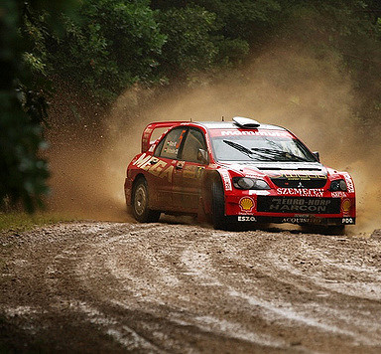
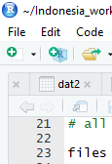
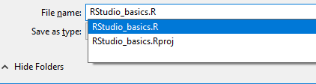
Let’s get our hands dirty!
Open a new script page and save it
Scripts are essentially a collection of code
It is good practice to name and organize your scripts based on what you’re trying to do
This will be useful for your future R sessions

Slide 10
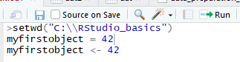
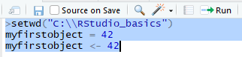
Let’s get our hands dirty!
#My first object
myfirstobject = 42
myfirstobject <- 42
Throughout the course you will be asked to copy lines of code.
The lines of code to be copied in your script will appear with the following font and color coding.
Look out for this font and try to not copy text that does not correspond to this.
Single lines of code:Keep the cursor on the line of code you want to run and press ctrl + enter, or the button Run
Multiple lines of code:Select the line of codes you want to run with your curso and press ctrl + enter, or the button Run

Slide 11
Let’s get our hands dirty!
First we set the working directory: copy and paste the location of the folder RStudio_basics into the code
Change the single \ to a double one \\ or to /
setwd("path")
Next we're going to create our first object!
You can also use "<-" to assign an object
myfirstobject = 42
myfirstobject <- 42
Copy and paste Code

Slide 12
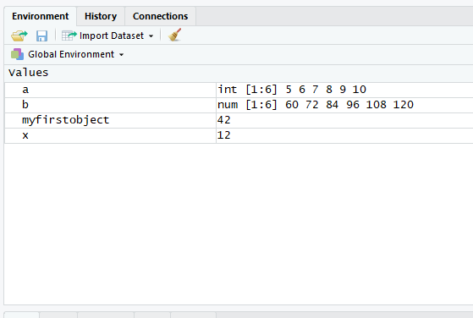
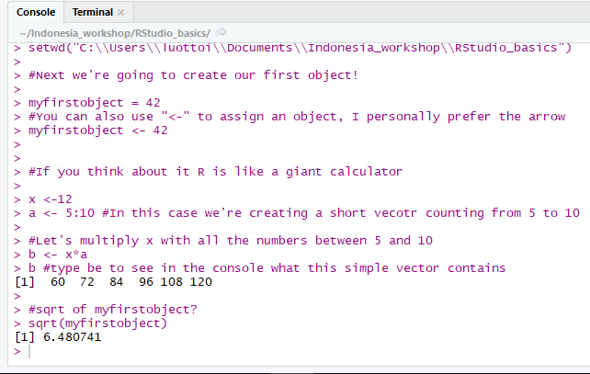
R as a giant calculator
# are for #comments in your script
Operators: + - / *
a <- 5:10 #In this case we're creating a short #vector counting from 5 to 10
#Let's multiply x with all the numbers between 5 #and 10
b <- x*a
b #type b to see in the console what this #simple vector contains
#sqrt of myfirstobject?
sqrt(myfirstobject)
Question 1:
Square root of 142?

Slide 13
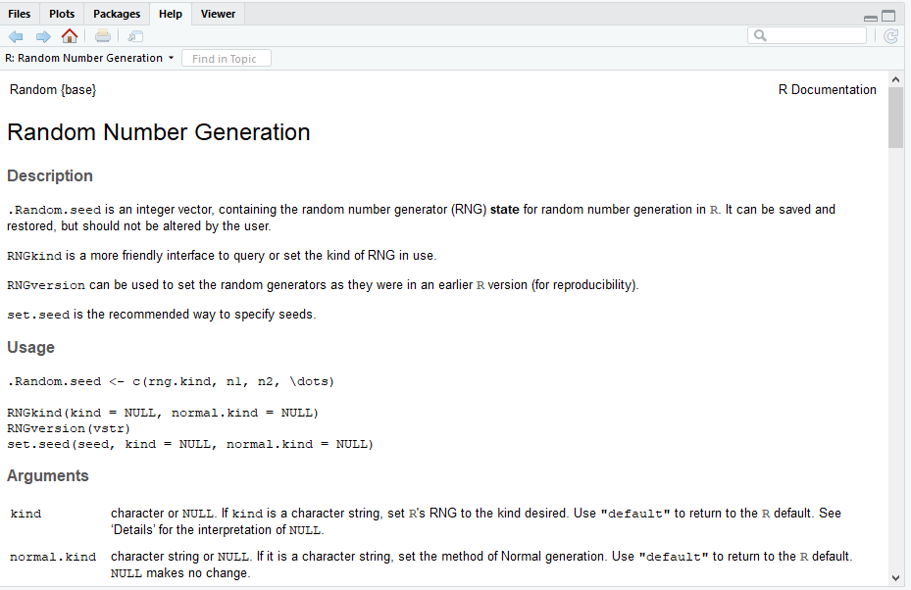
R Functions
R is a higher programming language meaning that the functions (e.q. sqrt(), hist() and maaaany more) were already written for you
Let’s take a look at some functions and at how they can be customized
#Set seed is a function to make a
#random sample reproducible
?set.seed #we can get some info in
#the help pane by using "?"
set.seed(42)

Slide 14
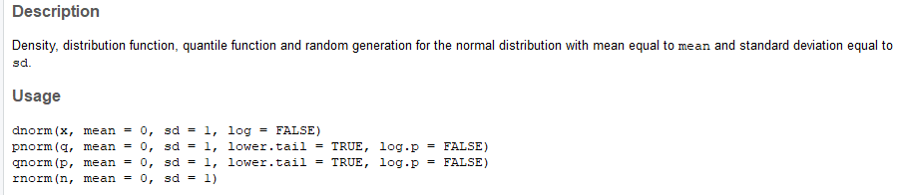
R Functions
To see how the function is structured and how you can customize the tool “?” is essential
In this example we can see what each number within the brackets and commas of the function rnorm does
?rnorm #if you leave something between the commas blank it goes #to default

Slide 15
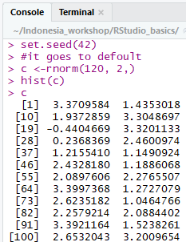
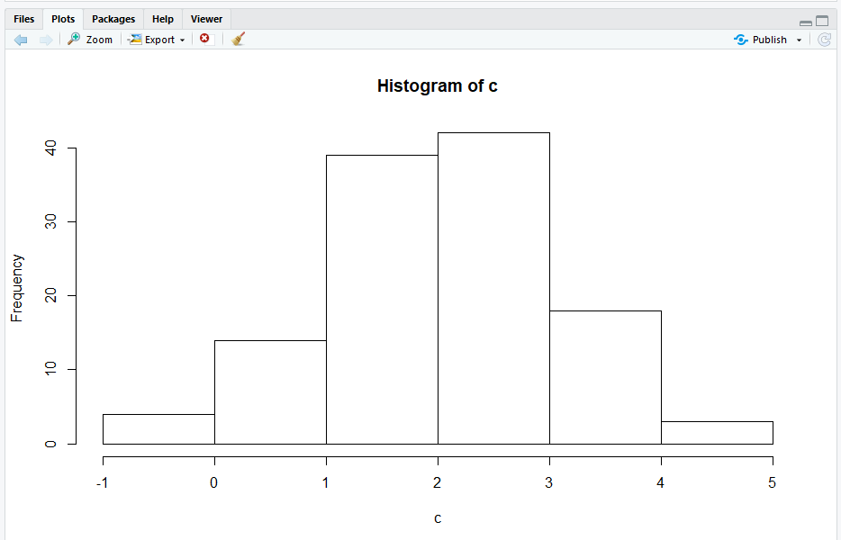
R Functions
To see how the function is structured and how you can customize the tool “?” is essential
In this example we can see what each number within the brackets and commas of the function rnorm does
?rnorm #if you leave something between the commas blank
#it goes to default
b<-rnorm(120, 2,)
hist(b)
b
Question 2: What is the first number appearing when running b?

Slide 16
Three common Error sources in R
Installing and loading packages
Case sensitivity
Concatenation

Slide 17
Three common Error sources in R
Installing and loading packages
R base relies on user contributions (packages) for many of its functions
When starting a new session of R the packages need to be loaded each time
Add-on packages may be required when running a script make sure to have them installed
#If you see this in your script
library("raster") #or
require("raster")
#And you don’t have the installed than you should run this line
install.packages('raster')

Slide 18
Three common Error sources in R
Installing and loading packages
During the workshop we will need several packages please install them now:
# Install all required R packages used in the training
install.packages(c("aqp", "automap", "car", "caret", "e1071",
"htmlwidgets", "leaflet", "mapview",
"Metrics", "openair", "plotKML", "psych",
"quantregForest", "randomForest", "raster",
"rasterVis", "reshape", "rgdal", "RSQLite",
"snow", "soiltexture", "sf", "sp"))
# Alternative spline function using the ihir package if GSIF doesn't install
install.packages("devtools")
library(devtools)
install_bitbucket("brendo1001/ithir/pkg")

Slide 19
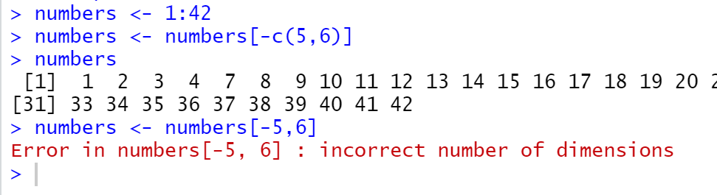
Three common Error sources in R
3. Concatenation
The c() function allows you to put an entire vector into a function instead of a single value
numbers <- 1:42
numbers <- numbers[-5,6]
#Error in numbers[-5, 6] : incorrect number
#of dimensions
numbers <- numbers[-c(5,6)]
numbers

Slide 20
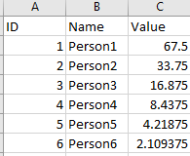
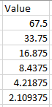
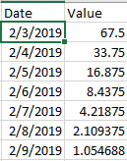
Types of Objects in R
A data object can be a dataframe, a result of a calculation, a function etc., that you assign a name to
There are different object classes (factor, integer, numeric, etc.) that determine what you can do with an object
Lists are a collection of objects or different data types
Data frame:
Numeric Vector:
Time series:

Slide 21
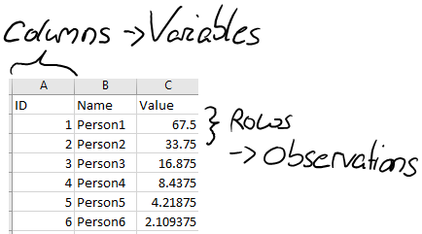
Datasets and dataframes
Columns can have different data types (numeric, integer, logical, character, factor)
All columns must have the same length
Data frame:

Slide 22
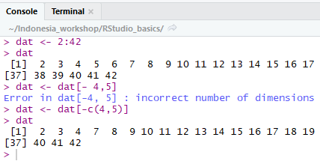
Indices
Numbers within the [ ] indicate the position of an object, e.g. in vectors the position of a number
dat <- 1:42
dat
dat <- dat[- 4,5]#[]are indices
dat <- dat[-c(4,5)];dat
dat <- 2:42
dat
Question 3: What numbers do you have to insert to get rid of the numbers 9 and 42? dat <- dat[-c(?,?)];dat

Slide 23
Datasets and dataframes
R has many example datasets to practice on (e.g. iris and mtcars)
In this example we’re going to use iris and assign it to the object data.frame dat.
dat <- data.frame(iris)
Here are some ways to explore your dataframe.
View(dat)#Opens up a window showing you the whole dataset.
#You can also open it from the global environment by clicking on it
head(dat) #first 6 observations. tail(dat) gives you the last 6
names(dat) #Tells you the names and position of each variable
str(dat)#how many variables, observations, the class/type of data
summary(dat)#Tells you about the distribution of the data
#Minimum, Mean,Median,Maximum of each variable
Question 4: What’s the mean overall petal length?

Slide 24

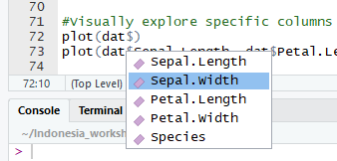
Datasets and dataframes
R has many example datasets to practice on (e.g. iris and mtcars)
In this example we’re going to use iris and assign it to the object data.frame dat
dat <- data.frame(iris)
Here are some ways to explore your dataframe
#Visually explore specific columns
hist(dat$Sepal.Width)#The $ sign allows you
#to select specific columns
plot(dat$Sepal.Length, dat$Petal.Length)
boxplot(dat$Petal.Width)

Slide 25
Datasets and dataframes
Let’s add another column. The new column will contain the species names with the number 2 attached to them and will be called “Species2”
dat$Species2 <- paste(dat$Species, 2)#with the $ sign you can #create a new column. The paste function allows you to add #sequences to characters. This is useful when creating an ID
View(dat)
Let’s check out the class type of the new column and change it to factor
str(dat)
dat$Species2 <- as.factor(dat$Species2); str(dat)

Slide 26
Datasets and dataframes
To change the name of the columns we can use setnames()
names(dat)#check the name and position of each variable in the #console
[1]"Sepal.Length""Sepal.Width""Petal.Length""Petal.Width""Species"
dat <- setNames(dat, c("SL","SW","PL","PW","S")) ;head(dat)
#the ; allows you to run two commands in the same line
Calculate the mean Petal.Length
mean(dat$PL)
Question 5: What’s the standard deviation of the petal length?

Slide 27
Working directory
To tell R in which folder we are working we need to set the working directory with the setwd() function. Ideally the working directory should contain all the folders and files needed to execute the script in its entirety.
#Tell R in which folder you are working
# R understand / and \\ but not \ (standard in windows)
setwd(“path to the folder ”)

Slide 28
Exporting a dataset
Let’s try exporting the train dataset as a csv
write.csv(dat, file= "iris2.csv")#Put the
#name of the file in ""
#If you want to save the file somewhere else other than the wd you #just have to specify where
write.csv(dat, file= "folder_path/iris2.csv")
You can export it into other formats as well with the functions
write.table()#Saves it as a .txt file
write.xlsx()#it requires the package xlsx

Slide 29
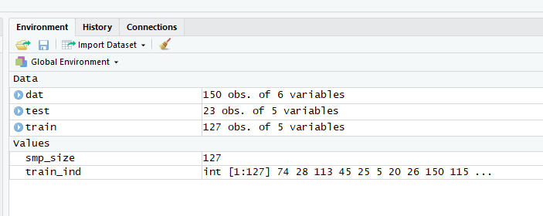
How to import datasets
iris2 <- read.csv(file.choose()) #with file.choose() you don't #have to write file location BUT it can freeze your R session
read.table()# for .txt files
read.xlsx()# requires the package xlsx

Slide 30
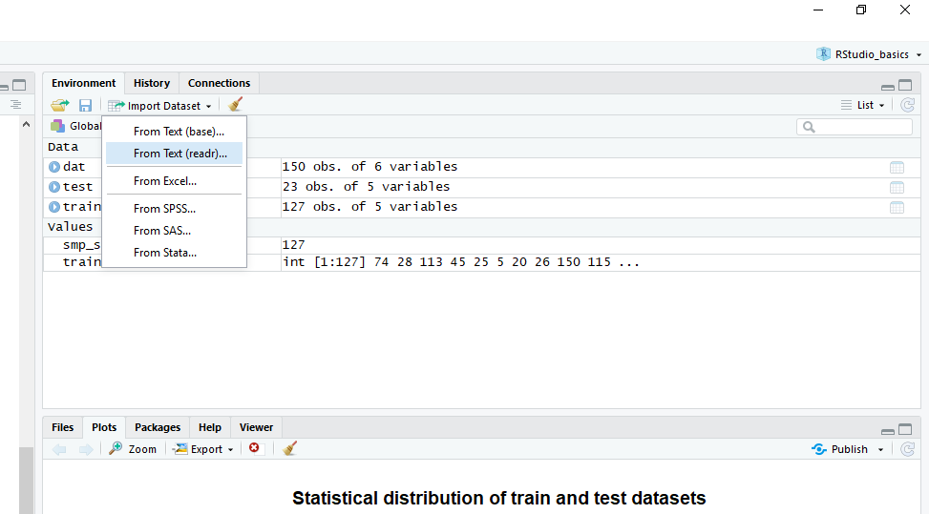
Importing data with readr

Slide 31
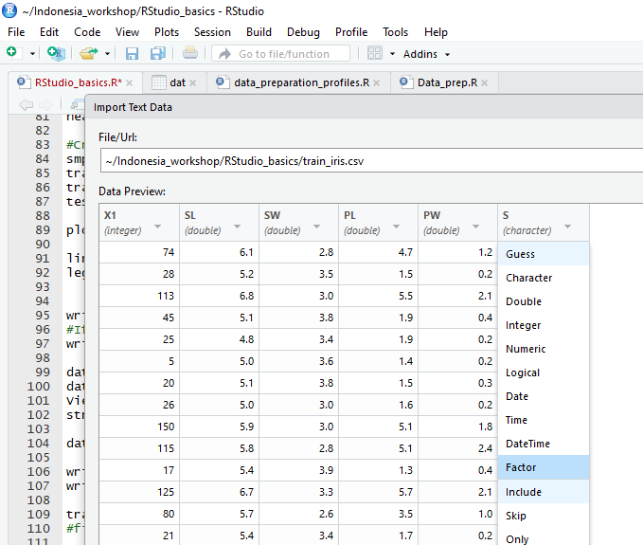
Importing data with readr
You can define the data type of a specific variable directly when importing
In this example we’re defining that the species is a factor

Slide 32
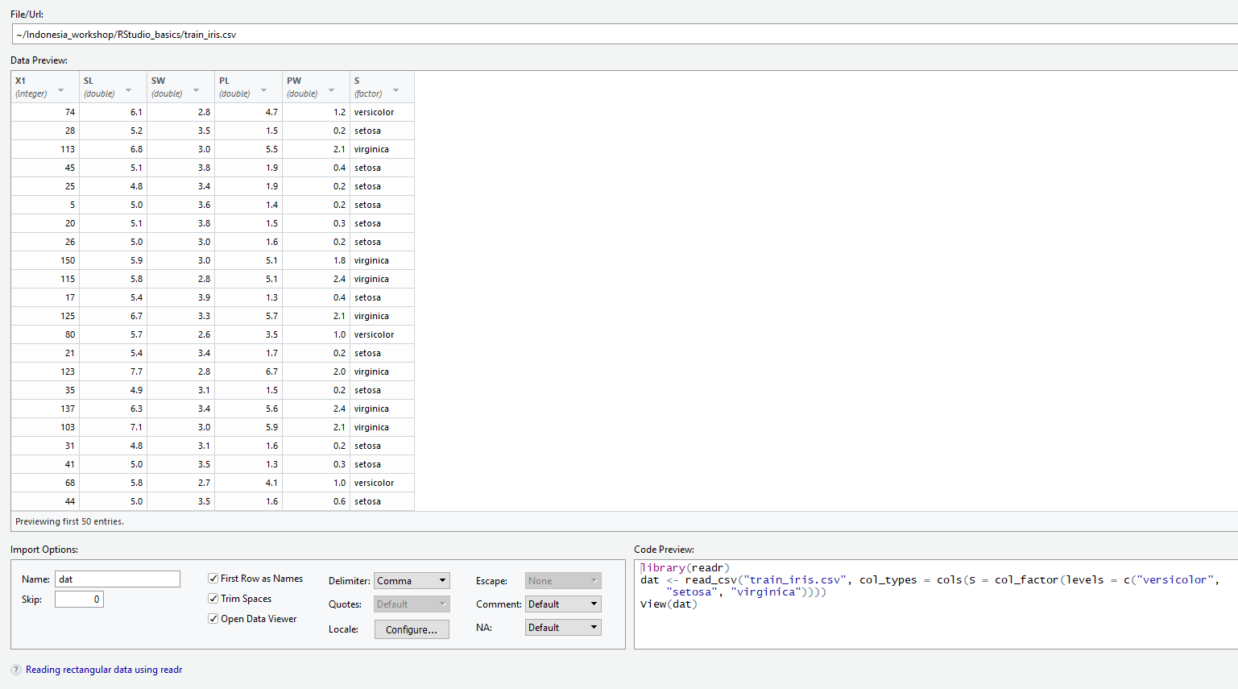

Slide 33
Conditional Selection []
Show only certain rows or columns [row index , column index] a way to remember this is by saying: rows comma column
dat[c(1,2), ]#by leaving the section after the comma blank we’re selecting all the columns
dat <- dat[ , -6];head(dat)#let’s get rid of the last column
This is one way to create a random subsample of the data
#Create a random subset with 85% of the data
smp_size <- as.integer(0.85 * nrow(dat))#define the subsample size
train_ind <- sample(seq_len(nrow(dat)), size = smp_size)
train <- dat[train_ind, ]
test <- dat[-train_ind, ]
wrist.csv(train, file = "train_iris.csv")
wrist.csv(test, file = "test_iris.csv")
Question 6: What number is in column 3 row 42?

Slide 34
Other logical operators
==, >, >=, <, <=, !=, &, | , %in%
Let’s subset the data for petals with a length greater than 5
Subset <- dat[dat$PL> 5,]
Let’s subset the data for petals with a length greater than 5 AND that are of the Setosa species
dat[dat$PL >5 & dat$S == "virginica", ]
Let’s subset the data for petals with a length greater than 5 OR that have sepals longer than 3
dat[dat$PL >5 | dat$SL > 3, ]
Question 7: How many observations are in the object Subset?

Slide 35
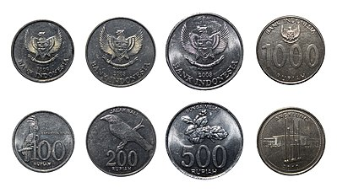
Other logical operators
%in% allows you to verify if an element is part of another object
It can be used for instance to get rid of outliers
Let’s add an outlier in our iris dataset
dat[c(9,3,4,6),4]=c(20,24,15,42)
View(dat)
==
TRUE
==
FALSE
%in%
TRUE

Slide 36
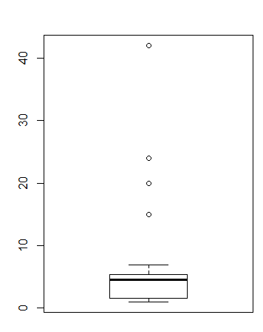
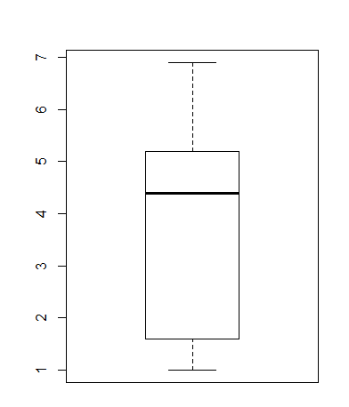
How to remove outliers
out <-boxplot(dat$PW, range = 1.5, plot= FALSE)$out
out
dat <- dat[-which(dat$PW %in% out),] ;boxplot(dat$PW)
View(dat)
boxplot(dat$PW)

Slide 37
R Basics
Spatial data

Slide 38
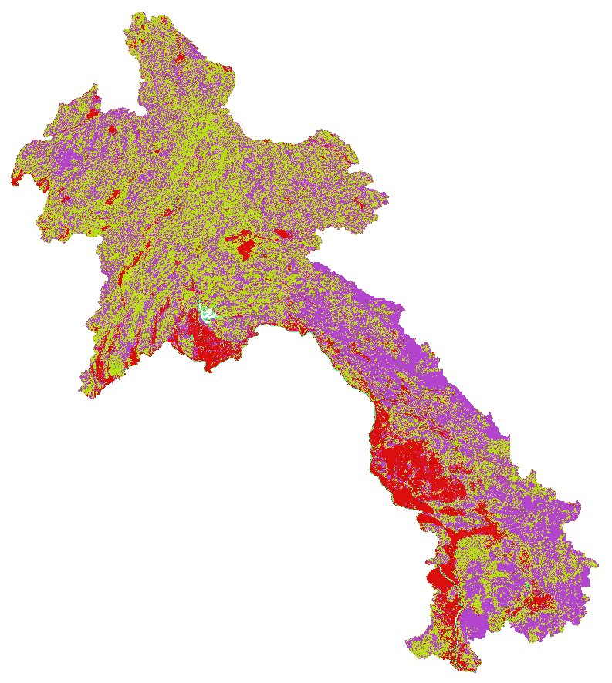
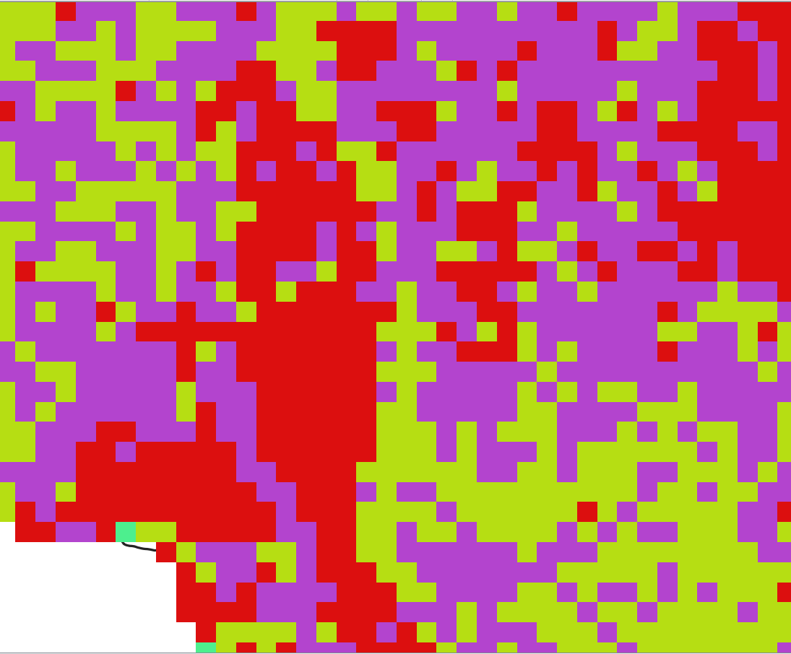
Rasters vs. Vectors
Raster: surface divided into a regular grid of cells
For storing data that varies continuously, as in a satellite image, a surface of chemical concentrations or an elevation surface.
Most common format: GeoTiff (.tif)
1 2
3 1

Slide 39
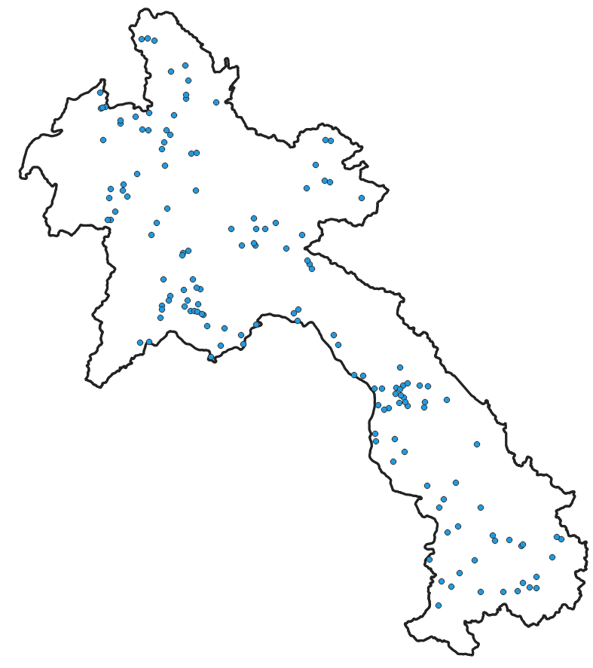
Rasters vs Vectors
Vector: points, lines and polygons
For storing data that has discrete boundaries, such as country borders, land parcels, and streets.
Format: shapefile

Slide 40
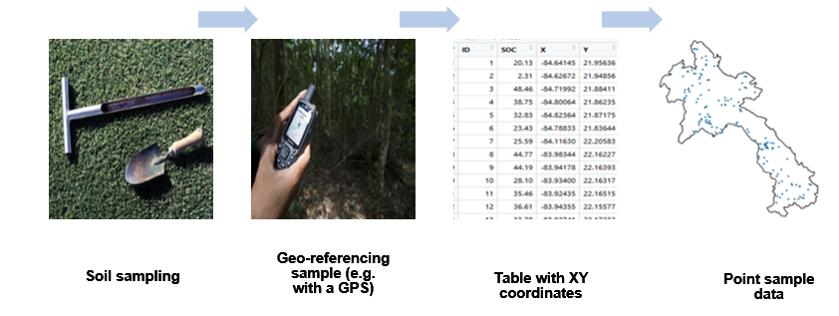
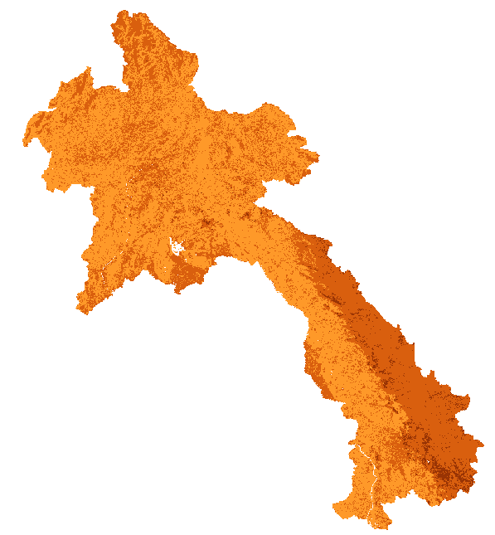
Digital soil mapping
In digital soil mapping we mostly work with data in table format and then rasterize this data so that we can make a continuous map
Modelling/Mapping

Slide 41
R packages for digital soil mapping
aqp | Algorithms for quantitative pedology We will use it to restructure our soil profile dataset into a database form that is easier to work with
raster | Reading, writing, manipulating, analyzing and modeling of gridded spatial data
rgdal | Provides access to the 'Geospatial' Data Abstraction Library ('GDAL') to projection/transformation operations from the 'PROJ.4' We will use it to the define the Coordinate Reference System (CRS)
sp | It is used to turn data frames into spatial objects (e.g. SpatialPointdataframe)

Slide 42
Working with spatial data in R
To familiarize with handling spatial data in R today we will
Load a raster and explore it
Explore some of the plotting functionalities
Match the extent of one raster to another
Make a rasterStack
Change the CRS of a raster
Save a raster
Load a data frame with XY coordinates
Plot points and overlay them over a raster

Slide 43
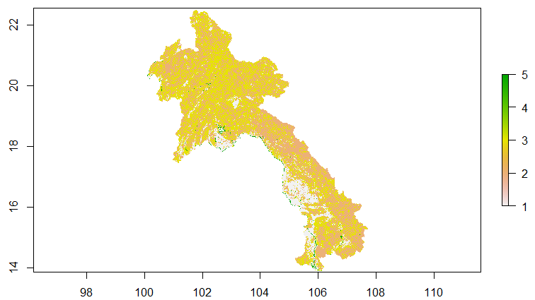
Load a raster file into R
Most of the functions for handling raster data are available in the raster package
library(raster)
landcover <- raster("01-Data\\land cover\\LandCover.tif")
#Let's check the CRS and extent of
#our landcover map
landcover
plot(landcover)#Let's plot our lc
summary(landcover)

Slide 44
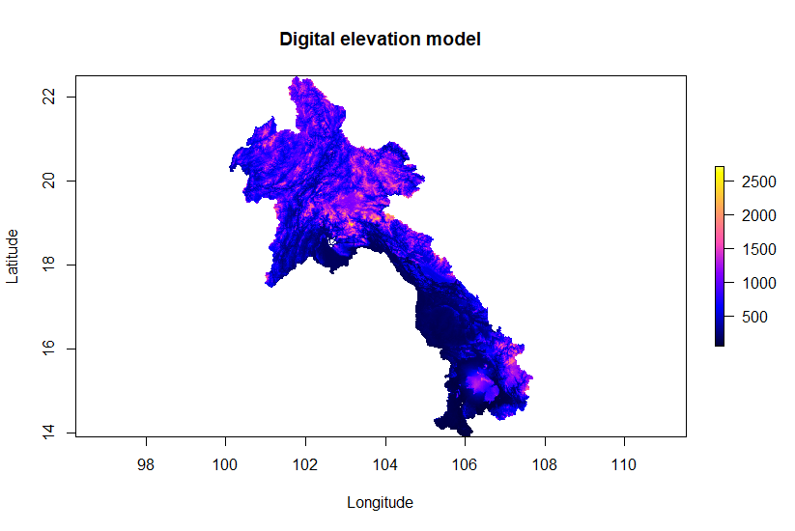
Load a raster file into R
Most of the functions for handling raster data are available in the raster package
Let’s load a digital elevation model
DEM <- raster("01-Data\\covs\\DEMENV5.tif")
#You can customize your map similarly
#like we did for the graphs
plot(DEM, col = bpy.colors(255),
main= "Digital elevation model",
xlab = "Longitude", ylab = "Latitude")
Question 8: What’s the exact highest point in our DEM?

Slide 45
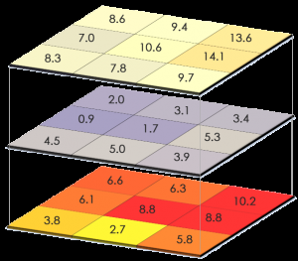
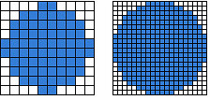
The RasterStack
Most of the functions for handling raster data are available in the raster package
Multiple layers can be combined into the object class RasterStack, which allows you to perform things on multiple rasters at once
Rasters can be stacked only if they have the same:
Extent (or in other words they cover the same area),
The same file extension
Same projection
Pixel resolution (cell size)

Slide 46
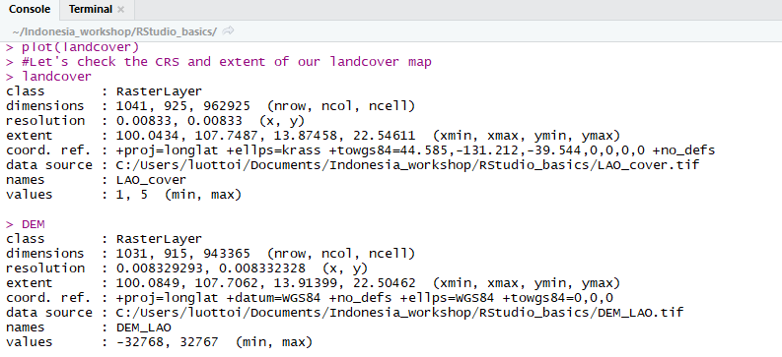
The RasterStack
#let’s try stacking our landcover and DEM map
lc_and_dem <-stack(landcover, DEM)
Error in compareRaster(x) : different extent

Slide 47
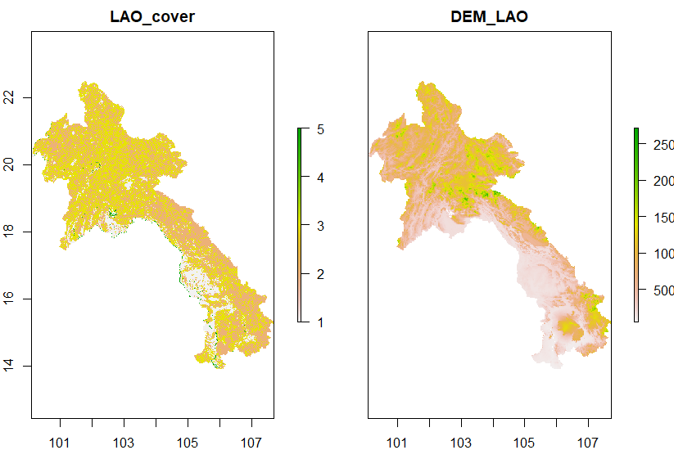
How to reproject a raster
#Match the extent and resolution to DEM
landcover <- projectRaster(landcover, DEM, method = 'ngb')
lc_and_dem <-stack(landcover, DEM)
plot(lc_and_dem)
#Now you can plot two
#rasters at the same time

Slide 48
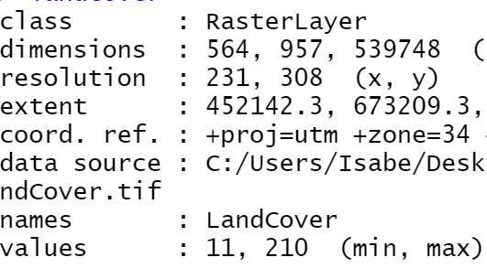
How to change the CRS of a raster
With the function reproject you can directly define the CRS of your raster
landcover <- raster("01-Data\\land cover\\LandCover.tif")#Reload #the original raster
#Let's check the CRS and extent of our landcover map
landcover

Slide 49
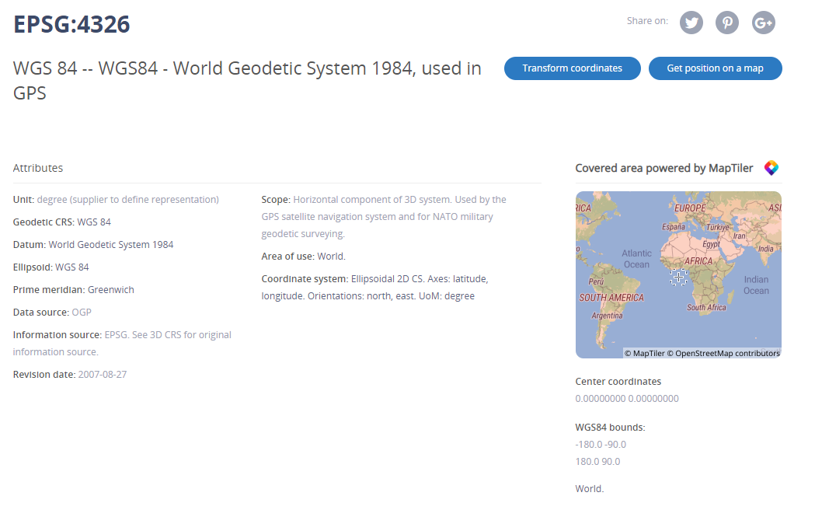
How to change the CRS of a raster
With the function reproject you can directly define the CRS of your raster
landcoverWGS84 <- projectRaster(landcover, crs = CRS("+init=epsg:4326"),method='ngb')

Slide 50
How to save a raster
The function writeRaster() allows you to save rasters in the .tif format
This function can also be used to change convert other formats to .tif
writeRaster(landcoverWGS84, file= "LandcoverWGS84.tif", overwrite=TRUE)

Slide 51
Let’s create a SpatialPointDataframe
SpatialPointsDataFrame structure is essentially like a data frame, except that additional “spatial” elements have been added
To define the CRS, we must know where our data is from, and what was the corresponding CRS used when recording the spatial information in the field
First we’re going to import a dataframe
#Import a csv file
points <- read.csv("01-Data\\site-level.csv")
head(points)

Slide 52
Let’s create a SpatialPointDataframe
Let’s turn our data frame into a SpatialPointDataframe
We can use the coordinates() function to tell R which columns contain a spatial reference
library(sp)
# Promote to SpatialPointsDataFrame
coordinates(points) <- ~ X + Y
#Check the the class
class(points)

Slide 53
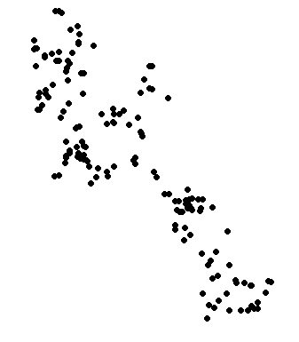
Plotting points
For now we only told R that our data frame contains XY coordinates, we still have to define the projection
#Let's define the projection to EPSG 4326
points@proj4string <- CRS(projargs = "+init=epsg:4326")
points@proj4string
#Let’s check the physical distribution of our data points
plot(points, pch = 16)

Slide 54
Overlay points on a raster
To overlay the points over a raster we use the points() function
First we need to make sure that that the raster and map are in the same projection
Plotting your data points is useful to explore the spatial distribution of your points (e.g. detect cluster, areas with very few representative points
landcover <- projectRaster(landcover, crs = CRS("+init=epsg:4326"),method='ngb')

Slide 55
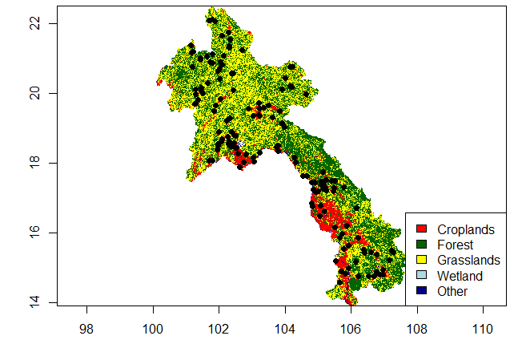
Overlay points on a raster
To overlay the points over a raster we use the points() function
#Let’s plot our land cover map and add a legend
plot(landcover, col= c("red", "darkgreen", "yellow", "lightblue", "darkblue"), legend= FALSE)
legend("bottomright", legend =
c("Croplands", "Forest", "Grasslands",
"Wetland", "Other"),
fill = c("red", "darkgreen","yellow",
"Lightblue", "darkblue" ))
#Check the distribution of the points
points(points, pch=16)

Slide 56




